Slide 1
Advancing the E in STEM A Collective Impact Approach

Slide 2
Collective Impact
A disciplined, cross-sector approach to solving complex social and environmental issues on a large scale.
DOES NOT: | DOES:
Employ a single organization or sector approach Focus solely on programmatic outcomes Work on short term priorities Resolve simple or complicated problems | Require a backbone investment to steward the collective work forward Require diverse perspectives Use data to inform the issue and outcomes Focus on the systemic barriers Leverage policy change opportunities Leverage existing assets and programs in an intentional and aligned way Focus collective resources on Impact priorities

Slide 3
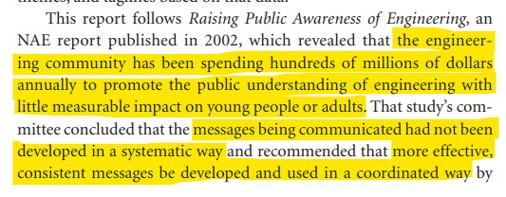
Advancing the E in STEM….Why?
Through research and our experience in the field, we know that there are significant gaps and duplications of efforts within K -12 STEM engagement across Canada.
STEM teaching in the Canadian K-12 school system has increasingly become a priority for Canada’s federal and provincial governments.
Despite this, the literature shows that Canada is lagging behind the top five innovator countries in STEM innovation.
From NAE’s Changing the Conversation Report, 2009

Slide 4
SYSTEMIC APPROACH: Why are we focussed on the E in STEM?
It gives us a clear focus!
Engineering is uniquely positioned for this work due to the existing framework in place and collaboration opportunities
As a profession, engineering already understands working collectively (e.g. 30 by 30).
Research exists that validates this approach…and there is some low hanging fruit.
What is Engineers Canada’s role?
Reference: National Membership Report (2022)

Slide 5
The Opportunity Defined
Clear understanding about how engineering shapes everyday solutions
Agreement of a common language and key messages
Coordinated leadership across the system – universities, schools, organizations
Alignment of organizations engaged in advancing STEM
Clear engineering pathways through K-12 to university and college
More diverse representation in engineering
Better retention of engineering undergrads
More support for students to get accepted into engineering programs
What do you think is the BIGGEST opportunity?

Slide 7
A coordinated approach – advancing the E in STEM
Shared Practice | Build a common language and shared practice
Focus on Data | Develop a data-driven approach – learn from gains in related fields including biology, health, and law Learn from qualitative and quantitative measures
Removing Barriers | Provide access to engineering for everyone Remove the barriers that threaten engineering confidence; including the culture of ‘I hate math’
Nurturing Partnerships | Nurture and create dynamic partnerships that cross-pollinate to advance the E in STEM
A Common Curriculum | Work across systems to build a common curriculum and pathways for students
Desired Outcomes
A common language and focused approach to bring young people (K – 12) into engineering and STEM
An increased understanding that engineers have an impact and help the world
A clear path into engineering for high school students and their parents is identified
Engagement is built across key partners including government, school boards and delivery partners which leads to a pan-Canadian curriculum
The engineering profession is more diverse and representative of Canadian demographics

Slide 8
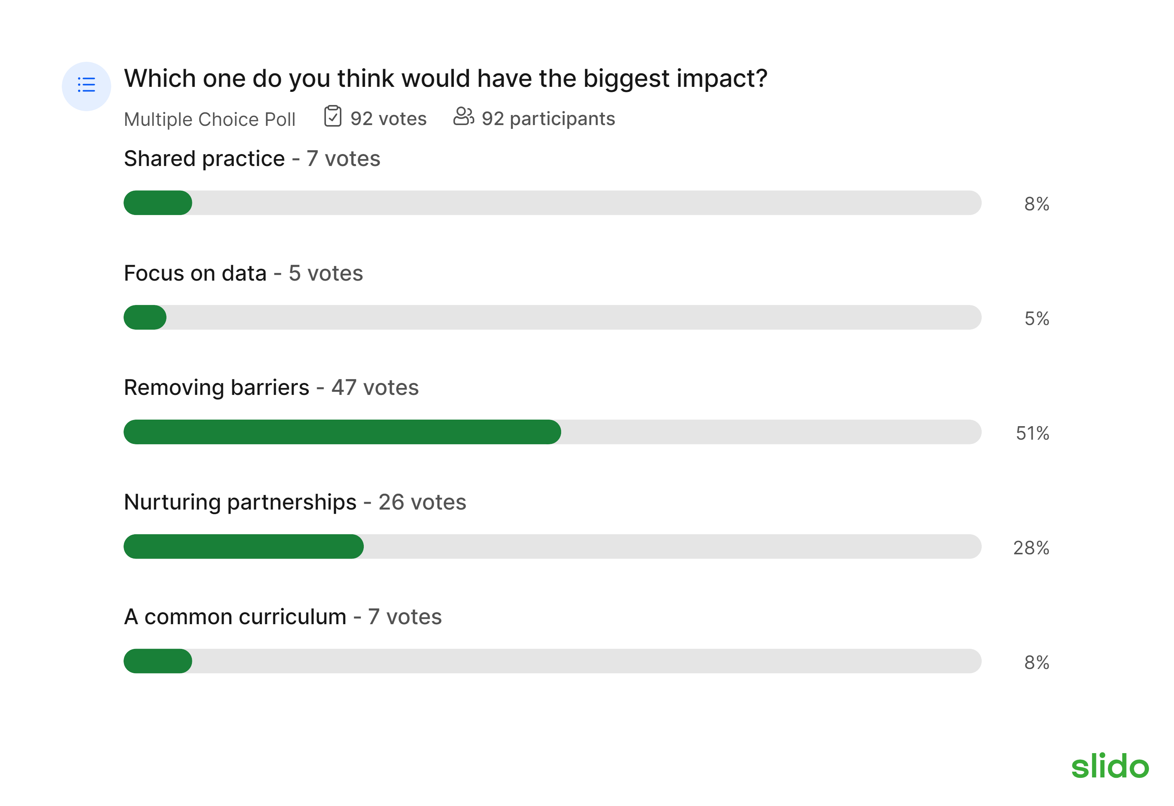

Slide 9
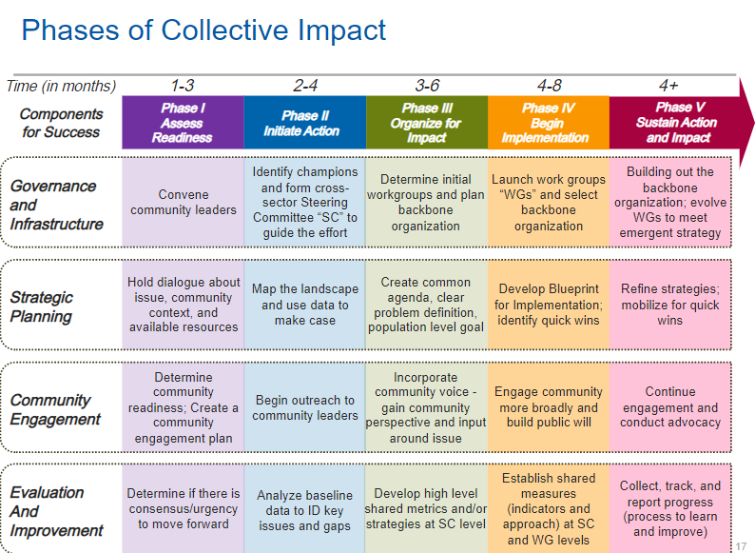
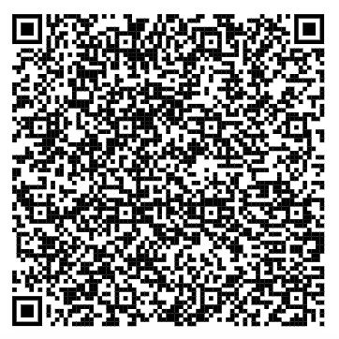
Five Phases of Collective Impact – Call to action!
Reach out if you’re interested in joining the collective work!
rebeccawhite@
engineersoftomorrow.ca

Slide 10
Thank you!

